Slide 1

VAMM and Binance fees

Slide 2
VAMM ?
Perpetual Protocol’s vAMM uses the same x*y=k constant product formula as Uniswap.
As the “virtual” part of vAMM implies, there is no real asset pool (k) stored inside the vAMM itself.
Instead, the real asset is stored in a smart contract vault that manages all of the collateral backing the vAMM.
In contrast to traditional AMMs, Perpetual Protocol uses a vAMM as a price discovery mechanism, but not for spot trading.

Slide 3
example showing how a vAMM works ?
Before a vAMM is created on the blockchain, the creator sets the number of virtual assets stored inside the vAMM.
Suppose the price of ETH is traded at 400 DAI, the creator can set an initial amount of ETH and DAI on vAMM with a ratio of 1-to-400.
For simplicity, we assume the creator sets the initial state on that vAMM as 100 vETH and 40000 vDAI.

Slide 4
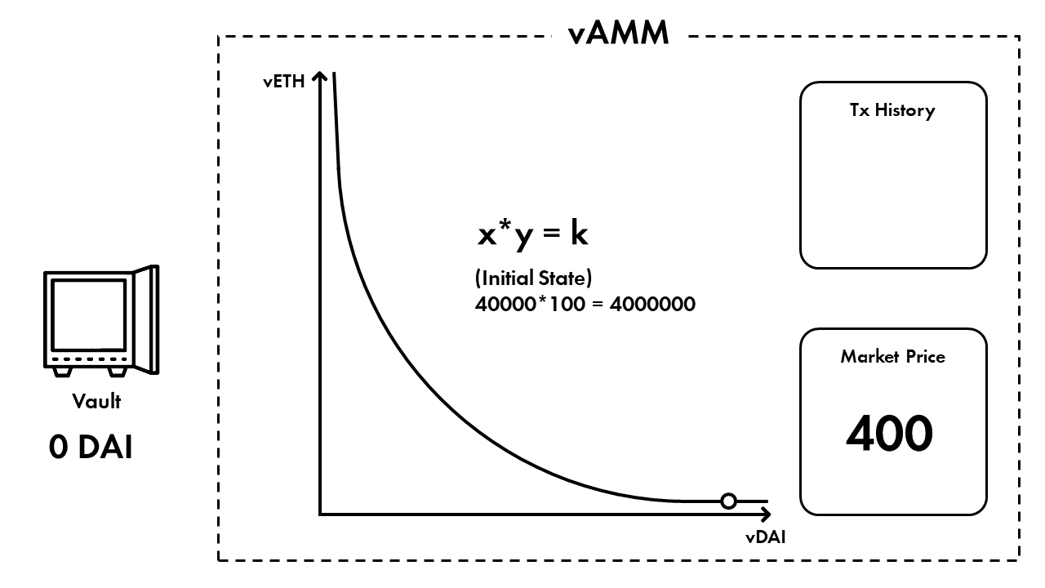

Slide 5
2. Trader Alice wants to go 10x long ETH with 100 DAI as collateral:
Alice deposits 100 DAI into Perpetual Protocol’s vault, which, as mentioned above, is a smart contract on Perpetual Protocol.

Slide 6
Perpetual Protocol credits 1,000 vDAI (10x leverage on 100 DAI) from Alice to the vAMM, which, in return, calculates the amount of the vETH that Alice receives according to a constant function (x*y = k).
Perpetual Protocol records that Alice now has 2.4390244 vETH and the state inside this vAMM becomes 97.5609756 vETH and 41000 vDAI.

Slide 7
3. Trader Bob then goes 10x short ETH with 100 DAI as collateral, meaning that:
Bob deposits 100 DAI into the same vault

Slide 8
Perpetual Protocol credits -1,000 vDAI from Bob to the vAMM, which, in return, calculates the amount of the negative vETH that Bob receives according to a constant function (x*y = k).
Perpetual Protocol records that Bob has now shorted 2.4390244 vETH and the state inside this vAMM now becomes 100 vETH and 40000 vDAI.

Slide 9
The Unique Properties of vAMMs
No liquidity providers needed.
Because of path independence, vaults will always have enough collateral to pay back all the traders trading against vAMMs (assuming all the under-collateralized assets are successfully liquidated before going bankrupt)
In contrast to conventional AMMs whose liquidity comes from liquidity providers contributing assets to facilitate trades, the liquidity for vAMMs comes directly from the vault sitting outside of the vAMM.
In other words, there is no need for the existence of liquidity providers to bring liquidity for a vAMM to work: the traders provide liquidity to each order.
Since no liquidity provider is required in a vAMM, there is no impermanent loss, to begin with.

Slide 10
Periodic price alignment.
The vAMM itself acts as an independent cash-settlement market.
If we want to make the vAMM market price close to an underlying index, we need to add a funding rate, similar to funding payments for perpetual contracts on central limit order book (CLOB) exchanges.
The funding payments incentivize arbitrageurs to bring the market price back as close as possible to the underlying index and make the vAMM market track the underlying index.

Slide 11
Managing slippage.
For vAMMs, similar to conventional AMMs, traders suffer less slippage when the value of K is higher — but the similarity ends there.
For conventional AMMs, the only ways to increase the value of K are 1) encouraging more liquidity providers to provide more liquidity, or 2) increasing the transaction fee, and recycling trading profits to provide more liquidity.
In contrast, in vAMMs, since the value of K is set manually by the vAMM operator at launch, it can be increased or decreased at will at any time, even after the vAMM is created, which helps the market respond to the latest conditions.
That being said, despite the vAMM operator having this kind of power, he/she cannot move the funds saved inside the Vault.
For example, K could be set as a function of volumes, open interest, funding payments, volatility, and other variables.
Setting the value of K is a delicate balance.

Slide 12
What is a Dynamic vAMM (DAMM)?
Drift’s Dynamic vAMM builds on the concept of a virtual AMM, with mechanisms to ensure optimal slippage and liquidity for traders by ensuring that prices are always trading at the part of the curve with the deepest liquidity and that the available virtual liquidity corresponds to the trading demand available.
Contract prices that track an underlying oracle price closely. This is ensured by a funding rate mechanism that charges interest for positions that push prices out of convergence.
Deep liquidity for market orders shown by low slippage for traders. If slippage is too high, this means that the demand for trading was higher than the estimated demand implied by the amount of virtual assets.

Slide 13
What’s the difference between a vAMM and a DAMM?
A virtual AMM is a negative-sum system; the maximum profits a trader can make is equal to the total collateral deposited by others into the pool, minus cumulative fees paid.
A dynamic virtual AMM (DAMM) is closer to a fair zero-sum game; the fees that traders pay to the system are given back to traders who hold positions in the system via adjusting the k-constant and the terminal price to incentivise longer-term growth in volume and open interest over time.
This means that in a DAMM, slippage should remain dynamically low even as trading interest in the vAMM grows. In a DAMM, the virtual reserves in a pool grows as demand to trade grows.
Reference - https://driftprotocol.medium.com/deep-dive-into-drifts-dynamic-vamm-part-1-3-c2121fbce3c4

Slide 14
Binance fee structure
What Do "Maker" and "Taker" Mean?
Taker:
When you place an order that trades immediately before going on the order book, either filling partially or fully, those trades will be "taker" trades.
Trades from Market orders are always Takers, as Market orders can never go on the order book. These trades are "taking" volume off of the order book, and therefore called the "taker.“
Maker:
When you place an order that goes on the order book partially or fully, such as a limit order, any subsequent trades coming from that order will be as a “maker.”
These orders add volume to the order book, helping to "make the market," and are therefore termed the "maker" for any subsequent trades.

Slide 15
“Taker” is an order that trades at a market price, “Maker” is an order that trades at a limited price.
Level | 30d Trade Volume (BUSD) | and/or | BNB Balance | USDT Maker / Taker | USDT Maker/TakerBNB 10% off | BUSD Maker / Taker | BUSD Maker/TakerBNB 10% off
Regular User | < 15,000,000 BUSD | or | ≥ 0 BNB | 0.0200%/0.0400% | 0.0180%/0.0360% | -0.0100%/0.0230% | -0.0100%/0.0207%
VIP 1 | ≥ 15,000,000 BUSD | and | ≥ 25 BNB | 0.0160%/0.0400% | 0.0144%/0.0360% | -0.0100%/0.0230% | -0.0100%/0.0207%

Slide 16
How to calculate the commission for Coin-margined contracts?
Commission fee = notional value*fee rate
Notional value = (number of contracts*contract size) / trade price
For example, regular user's marker commission: 0.015%; taker commission: 0.040%
Buy 10 BTCUSD 0925 quarterly contracts using Market order:
Notional value = (number of contracts*contract size) / opening price
= (10 contracts*100 USD) / 10,104 USD
= 0.09897 BTC
Taker commission fee: 0.09897*0.040% = 0.00003959 BTC
After the price increases, sell 10 BTCUSD 0925 quarterly contracts using Limit order:
Notional value = (number of contracts*contract size) / closing price
= (10 contracts*100 USD) / 11,104 USD
= 0.09 BTC
Maker commission fee: 0.09*0.015% = 0.00001351 BTC
Note: For quarterly delivery contracts, a flat 0.015% of settlement fee is charged for all positions settled on the delivery date.

Slide 17
Thankyou!!!!

